Slide 1




Explore Secure Travel Insurance
IE 6700

Slide 2
Background Information
The travel insurance industry plays a vital role in ensuring security for travelers across various demographics.
The project aims to provide personalized travel insurance management, offering specialized support for high-risk groups like journalists, athletes, and senior citizens.

Slide 3
Business Problems
Diverse traveler needs require customized coverage.
High-risk groups need specialized policies.
Claim resolution for urgent cases, especially journalists.
Efficient management of customer profiles and agent commissions.
Stress on claims systems due to external events (pandemics, natural disasters).
Partnerships with travel platforms are essential for market growth.

Slide 4
Business Requirements
Customer Details:
Record personal information:
Policy Types:
Journalist Coverage: Medical emergencies, personal equipment, evacuation.
Infant & Child Coverage: Medical emergencies and trip delays.
Teen Coverage: Solo/group trips for teens, covering medical and trip issues.
Senior Couple Coverage: Medical issues, trip cancellations, evacuations.
Business Travel Coverage: Corporate equipment loss, missed meetings, baggage loss, medical issues.
Athletes and Teams Coverage: Injury protection, trip cancellations.
Travel Blogger Coverage: Personal equipment, trip cancellations, emergencies.
Claims Management:
Quick and efficient claims processing for urgent cases.
Tracking claim statuses: submitted, under review, resolved.
Sales & Performance Tracking:
Monitoring agent commissions and policy sales.
ID, name, gender, occupation, travel purpose, and risk level.

Slide 5
EER Model Overview
Entities:
Customers, Policies, Claims, Agents, Payments, Partnerships, Travel Platforms.
Key Relationships:
Customers purchase Policies (1:N)
Policies belong to Policy Types (M:1)
Claims are filed by Customers and processed by Agents (1:N)
Customers make Payments for Policies (1:N)
Travel Platforms partner with the insurance company to offer additional coverage options (M:N)

Slide 6
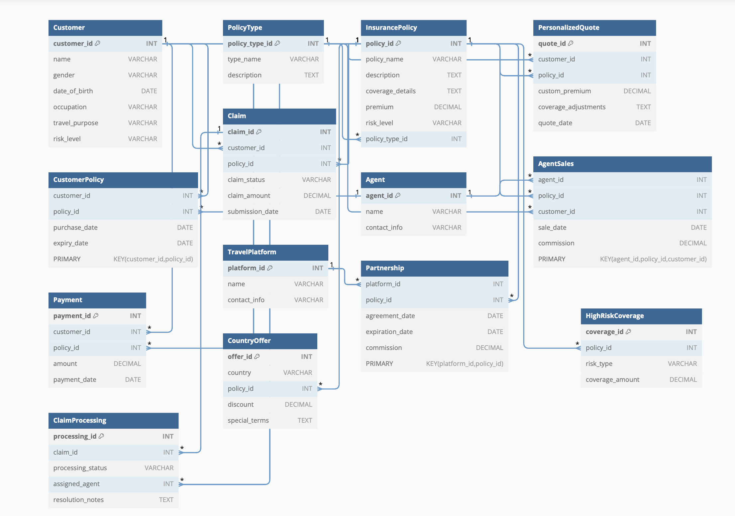
EER MODEL DIAGRAM

Slide 7
Relational Model
Customer: Customer_ID (PK), Name, Gender, DOB, Occupation, Travel_Purpose, Risk_Level
Policy: Policy_ID (PK), Policy_Type_ID (FK), Premium_Amount, Coverage_Details, Customer_ID (FK)
Claim: Claim_ID (PK), Claim_Status, Claim_Amount, Claim_Date, Policy_ID (FK), Customer_ID (FK)
Agent: Agent_ID (PK), Agent_Name, Commission_Rate
Payment: Payment_ID (PK), Payment_Amount, Payment_Date, Policy_ID (FK), Customer_ID (FK)
Agent_Sales: Sale_ID (PK), Agent_ID (FK), Policy_ID (FK), Sale_Date, Commission_Amount
Partnership: Partnership_ID (PK), Platform_ID (FK), Terms
Travel_Platform: Platform_ID (PK), Platform_Name, Platform_URL

Slide 8
Relationship Highlights
One Customer can hold multiple Policies, file multiple Claims, and make multiple Payments.
Agents sell policies (tracked via Agent_Sales) and may process Claims.
Policies are linked to Policy Types and Customers.
Travel Platforms connect through Partnerships to offer bundled services.

